Slide 1

L O D I Let Others Do It
CWRU Bootcamp Group Project Two
Brad Hersey Steve Mazanec Joe Wancho Rhonda Johnson

Slide 2
L O D I Application Concept
Let Others Do It
Information about Home Contractors
Contractors can be added to the database
Customers can leave a review and rating for a contractor
Contractor’s rating will be updated after each review
Customers can look for contractor in their area

Slide 3


Motivation to Create LODI
To provide a resource where users can find information about home contractors
User can leave feedback regarding their interaction with the contractor
User can submit a request to be contacted
Needing an API

Slide 4
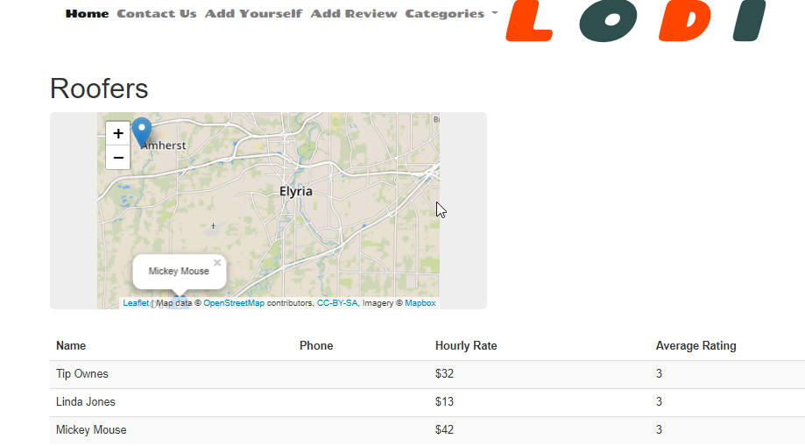
Design Process
Brainstorm on layout and functionality
Divide tasks
Design home page
Create data
Design other pages
Develop routing functionality

Slide 5

Design Process
Delegating. Each member volunteered different areas of the project.
Brad – design and layout
Joe – concept for project, name for app, gather / create data (names, addresses, images, reviews)
Steve – routing, map, table of contractors, handlebars, contact info/Firebase, new contractor form
Rhonda – routing, create and display customer reviews

Slide 6
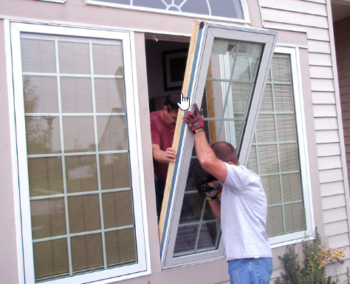
Technologies
Leaflet.js
Mapbox api
Tablesort – jQuery plug-in
Validation – npm jQuery validation
Node geocoder – to use with mapquest api

Slide 7

Technologies
CSS
Bootstrap
Javascript jQuery
JSON
jQuery Modal
AJAX
mySqL
sequelize

Slide 8
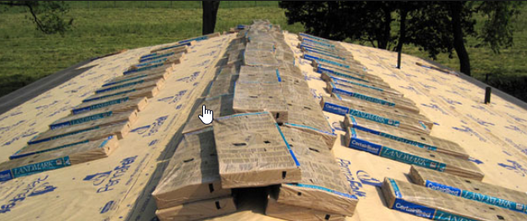
Challenges
GitHub
Getting dropdowns to work with bootstrap
Geocoder with mapquest
Using 2 tables – getting reviews associated with a contractor

Slide 9
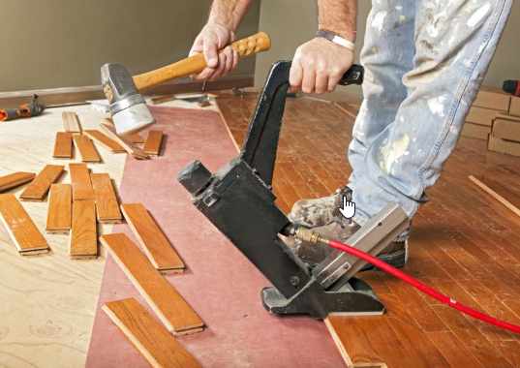
Challenges
Review modal to load when clicking a row
Modal Styling
Adding contractor picture into the database
Hiding API keys for client side code (Firebase)

Slide 10
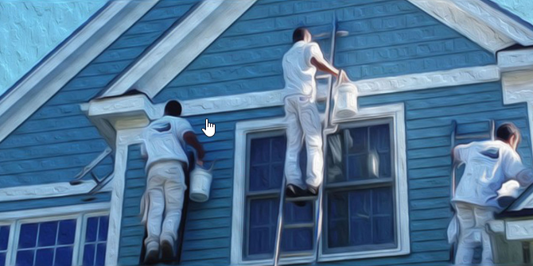

Homepage Challenges
Zoom functionality
Positioning
Need to change from css grid to bootstrap
Tried flexbox

Slide 11
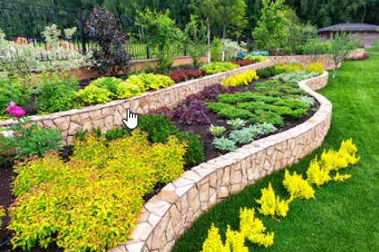
Future Updates
Allow user to upload image
Use API with real data
Contractors – login and authentication ; update own information
Mobile responsive homepage
Adding contractor picture on review modal
Admin login – edit or delete information
Remove alerts – some users block pop-ups

Slide 12

Demonstration
https://projectlodi.herokuapp.com/

Slide 13

Questions 0r Comments
Brad Hersey Steve Mazanec Joe Wancho Rhonda Johnson

